Slide 1
Once Upon a Thread
A guided tour through the concurrency monster ZOO
Jana Machutová

Slide 2
Once upon a time…
Do not enter
EARTHQUAKE
entered:
left:
…a developer spawned a thread.
void open_the_zoo() {
jthread entrance([] { admit_visitors(); });
jthread exit_gate([] { dismiss_visitors(); });
make_all_creatures_happy();
}
And everything seemed fine.
entered: 20 000
left: 19 801
entered: 20 000
left: 20 000
entered: 19 942
left: 20 000

Slide 3
What happened?
Wrong count Who wrote the same state at the same time?
Crash What outlived the object it touched?
Silence Why can nobody make progress?
Slow but correct Where did parallelism go?
Déjà vu What changed while we looked away?
The rest of the talk is the detective story
Which monster caused each symptom?

Slide 4
Welcome to the monster ZOO
Please keep your hands inside the critical section at all times

Slide 5
Zookeeper rule #1
Monsters don’t attack every visit.
That’s exactly why they are so good at hiding
A concurrency bug is a possible interleaving, not a guaranteed one
Your test suite sees a handful of interleavings - production sees tons of them
The narrower the timing window, the longer the monster sleeps
Logging and debugging can change the schedule
"It works on my machine" means the monster doesn't like the taste of your machine...yet

Slide 6
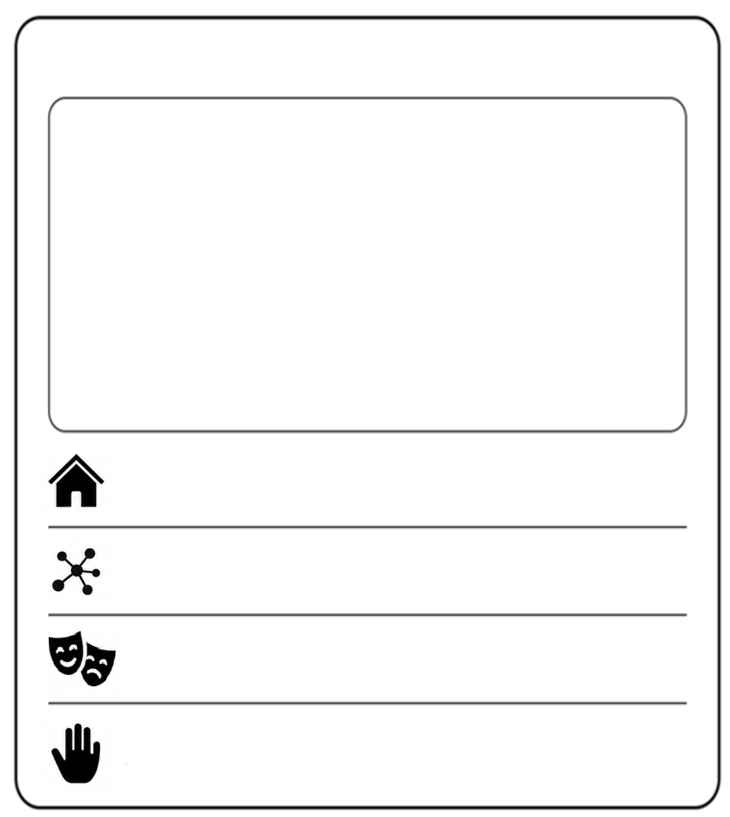




How to read a monster card
Each monster leaves four clues
Habitat where it nests in real code
Behaviour what it does to your program
Camouflage why you didn't see it in review
Taming how to keep it behind bars
Collect them all. No silver bullets included

Slide 7
Zone 1: The Petting ZOO
Small. Fluffy. Found in every codebase.
Visitors often try to take these home. Visitors are often wrong

Slide 8
The Greedy Goat
Friendly. Always hungry. Great with kids.
Eats leaves from little hands, snacks from backpacks, the power cord to its enclosure
… and your updates.

Slide 9
The Greedy Goat
Two gates, one visitor counter:
int visitors = 0;
jthread north_gate([&] { for(int i = 0; i < 10'000; ++i)
++visitors; });
jthread south_gate([&] { for(int i = 0; i < 10'000; ++i)
++visitors; });

Slide 10
The Greedy Goat
Two gates, one visitor counter:
int visitors = 0;
jthread north_gate([&] { for(int i = 0; i < 10'000; ++i)
++visitors; });
jthread south_gate([&] { for(int i = 0; i < 10'000; ++i)
++visitors; });
Expected: 20 000
Run 1: 11 482
Run 2: 19 032
Run 3: 14 629

Slide 11
The Greedy Goat
0 0 6 8
0 0 6 7
67 + 1 = 68
67 + 1 = 68

Slide 12
The Greedy Goat
This is a data race and therefore undefined behavior
int visitors = 0;
jthread north_gate([&] { for(int i = 0; i < 10'000; ++i)
++visitors; });
jthread south_gate([&] { for(int i = 0; i < 10'000; ++i)
++visitors; });
Convicted of UB

Slide 13
The Greedy Goat
atomic<int> visitors = 0;
jthread north_gate([&] {
for (int i = 0; i < 10'000; ++i)
++visitors;
});
jthread south_gate([&] {
for(int i = 0; i < 10'000; ++i)
++visitors;
});
unsynchronized non-atomic
read-modify-write
eats updates;
the more traffic, the hungrier
numbers remain plausible and low-load tests often pass
make the read-modify-write a single atomic operation

Slide 14
Zone 2: The House of Illusions
These monsters do not necessarily corrupt an individual operation.
They invalidate the assumptions connecting operations.

Slide 15
The Rabbit Hat
The good old trick. A hat and a rabbit. And then another.
How many rabbits could we fit inside?
It’s fun until it isn’t.

Slide 16
The Rabbit Hat
queue<rabbit> hat;
mutex m;
if (!is_hat_empty())
rabbit_to_pet = hat_pop();
bool is_hat_empty() {
lock_guard lock(m);
return hat.empty();
}
rabbit hat_pop() {
lock_guard lock(m);
auto r = hat.front();
hat.pop();
return r;
}

Slide 17
The Rabbit Hat
queue<rabbit> hat;
if (!is_hat_empty())
rabbit_to_pet = hat_pop();
if (!is_hat_empty())
rabbit_to_pet = hat_pop();
if (!is_hat_empty())
rabbit_to_pet = hat_pop();

Slide 18
The Rabbit Hat
queue<rabbit> hat;
if (!is_hat_empty())
rabbit_to_pet = hat_pop();
Convicted of UB
if (!is_hat_empty())
rabbit_to_pet = hat_pop();
if (!is_hat_empty())
rabbit_to_pet = hat_pop();

Slide 19
The Rabbit Hat
queue<rabbit> hat;
if (!is_hat_empty())
rabbit_to_pet = hat_pop();
The individual methods are safe.
No rabbit vanishes. The hat runs dry in the unlocked gap between the check
and the action.
The check-then-act sequence is not one indivisible operation.

Slide 20
The Rabbit Hat
optional<rabbit> try_pull_rabbit()
{
lock_guard lock(m);
if (hat.empty())
return {};
auto rabbit = hat.front();
hat.pop();
return rabbit;
}
empty() + pop(), contains() + insert(),
if (ptr) + dereference
another thread drains the supply
after you check it
every individual call is thread-safe
put the question and action under one lock

Slide 21
The Phantom Bellringer
Never seen. Never scheduled.
Rings when nobody is listening.
Rings when nobody asked it to.
Sometimes it rings just out of boredom and nothing happens at all.

Slide 22
The Phantom Bellringer
mutex m;
condition_variable bell;
queue<crate> deliveries;
void delivery_truck(crate delivery) {
{
lock_guard lock(m);
deliveries.push(delivery);
}
bell.notify_one();
}
void night_stocker() {
unique_lock lock(m);
bell.wait(lock);
stock(deliveries.front());
deliveries.pop();
}
Overnight deliveries arrive at the zoo gift shop’s loading dock.
The driver rings the service bell, and the night stocker shelves the next crate.

Slide 23
The Phantom Bellringer
Condition-variable waits may also return without a notification
This is a spurious wakeup.
Code must be correct regardless of why the thread woke.

Slide 24
The Phantom Bellringer
The truck came before the stocker’s shift. By the time the stocker arrived,
the bell had already rung.
Notifications are not stored for future waiters.
The stocker waits for the next ring while a crate sits on the loading dock.

Slide 25
The Phantom Bellringer
unique_lock lock(m);
bell.wait(lock, [] { return !deliveries.empty(); });
stock(deliveries.front());
deliveries.pop();
condition_variable::wait without a state predicate
sleeps through real events or wakes for no useful event
works whenever the waiter happens to arrive first
The predicate prevents both lost and spurious wakeup bugs.
wait for state, not for a bell

Slide 26
Zookeeper rule #2
A mutex is not just a door.
It is also a memory handshake
Change shared state while holding the mutex
Inspect it while holding the same mutex
The predicate is the truth
The notification is only a prompt to check again
For a single atomic flag or counter atomic::wait / notify may be simpler.

Slide 27
Zone 3: The Ruins
The next monsters do not break synchronization
They break lifetime.

Slide 28
The Runaway Ferret
Small. Fast. Impossible to keep in its enclosure.
Slips out before feeding time ends…
…and keeps chewing on variables that no longer exist

Slide 29
The Runaway Ferret
void manage_zoo() {
string menu = load_menu();
thread keeper([menu = string_view{menu}] {
follow_menu(menu);
});
keeper.detach();
menu = prepare_tomorrow_menu();
}
The capture is by value. What escaped?
The lambda owns its string_view - it does not own the characters the view refers to.

Slide 30
The Runaway Ferret
Possible outcomes:
An immediate crash when the late keeper follows the released menu
The ferret bites whoever now lives at that address and hurt it
The ferret eats whatever now lives at that address and gets sick
Capturing by value copies the object - not necessarily what it refers to.
Detach is what let the work outlive the menu and leads to use-after-lifetime UB

Slide 31
The Runaway Ferret
void manage_zoo() {
string menu = load_menu();
jthread keeper([menu = move(menu)] {
follow_menu(menu);
});
menu = prepare_tomorrow_menu();
}
detach(), string_view, span, iterators, fire-and-forget tasks
reads through a copied borrower after its owner is gone
the capture by value and the background work finishes quickly
The lambda owns the string.
The jthread owns and joins the execution.
give every thread an owner;
capture owning data

Slide 32
The Scavenger Jackal
Patient. Opportunistic. Arrives after everyone has gone home.
Finds an abandoned address…
…and writes into whoever lives there now.

Slide 33
The Scavenger Jackal
food_tray tray;
void open(zoo& owner) {
owner.on_feeding_time([this] {
tray.refill(prepare_jackal_meal());
});
}
The jackal enclosure registers for the next feeding time
The enclosure closes. The zoo still remembers the callback and its address.

Slide 34
The Scavenger Jackal
Possible outcomes:
An immediate crash when the callback follows the dangling address
A jackal meal poured into the new balloon stand
The balloon stand crashes later because one of its fields was corrupted
The callback holds a dangling this pointer.
Using it is use-after-lifetime and undefined behavior.

Slide 35
The Scavenger Jackal
shared_ptr<jackals>
open_jackal_enclosure(zoo& owner) {
auto enclosure = make_shared<jackals>();
weak_ptr<jackals> weak = enclosure;
owner.register_feeding_callback([weak] {
if (auto live = weak.lock())
live->feed();
});
return enclosure;
}
[this] captures, timers, callbacks, event loops, task executors
returns to an enclosure after the enclosure is gone
the event usually fires while the enclosure is still open
unregister and drain callbacks, or capture weak ownership

Slide 36
Zookeeper rule #3
Synchronization controls concurrent access.
It cannot keep a dead object alive.
Establish lifetime first, then synchronize shared access
Capturing this does not extend the enclosure's lifetime
A weak_ptr can be checked without keeping the enclosure alive forever
weak.lock() keeps a live enclosure alive for that callback invocation
An expired enclosure turns the callback into a no-op

Slide 37
Zone 4: The Crossing
Where all paths meet, and everyone reveals their true character.

Slide 38
The Gallant Reindeer
Polite. Disciplined. Keen to do the right thing.
No pushing. No fighting. No chaos.
Traffic management is not their gift.

Slide 39
The Gallant Reindeer
mutex west_half, east_half;
void cross_from_west() {
lock_guard west(west_half);
lock_guard east(east_half);
cross_bridge();
}
void cross_from_east() {
lock_guard east(east_half);
lock_guard west(west_half);
cross_bridge();
}
Two reindeer enter a narrow bridge from opposite ends. Each claims the half ahead and waits for the other half.
Neither retreats. Neither crosses.
This is deadlock.

Slide 40
The Gallant Reindeer
occupy(near);
if (try_occupy(far)) {
cross_bridge_and_release(near, far);
return;
}
release(near);
bow_and_retry();
They are active. They are courteous. They still never cross.
This is livelock.

Slide 41
The Gallant Reindeer
unique_lock bridge(bridge_mutex);
bridge_changed.wait(bridge, [&] {
return traffic == none || traffic == mine; });
traffic = mine;
++reindeer_on_bridge;
bridge.lock();
if (--reindeer_on_bridge == 0) {
traffic = none;
bridge_changed.notify_all();
}
Reindeer may join traffic already moving in their direction.
New arrivals keep joining the convoy. The bridge never empties, so other side
may wait forever.
This is starvation.

Slide 42
void cross_from_west()
{
scoped_lock bridge(west_half, east_half);
cross_bridge();
}
void cross_from_east()
{
scoped_lock bridge(east_half, west_half);
cross_bridge();
}
The Gallant Reindeer
multiple locks, synchronized retries, and unfair admission
deadlocks, livelocks, or leaves some threads waiting forever
each rule sounds reasonable and timing-dependent tests often pass
Simplicity is often the winning design.
Against complicated dances it can win the performance race too.
order coupled locks; block instead of retry; force a fair handoff

Slide 43
Zone 5: Performance Aviary
Every bird is safe, and every gate works as designed.
Yet today, even the strongest wings feel heavy.

Slide 44
The Turnstile Tern
The tern believes a well-run zoo has a rule for every step.
No shortcut, no exception, no visitor out of line.

Slide 45
The Turnstile Tern
mutex m;
void visit_aquarium() {
lock_guard lock(m);
++aquarium_visitors;
explore_aquarium();
}
void ride_carousel() {
lock_guard lock(m);
++carousel_riders;
buy_ice_cream();
}
Correct, but unrelated attractions are serialized
Too little synchronization breaks correctness.
Too much synchronization quietly removes scalability.

Slide 46
The Turnstile Tern
mutex aquarium_m;
mutex carousel_m;
void ride_carousel() {
{
lock_guard lock(carousel_m);
++carousel_riders;
}
buy_ice_cream();
}
void visit_aquarium() {
lock_guard lock(aquarium_m);
++aquarium_visitors;
explore_aquarium();
}
one giant lock around unrelated work
turns a multicore system
into a single-file queue
correctness tests pass; small demos have little contention
protect the smallest meaningful invariant

Slide 47
The Next-Door Sparrows
They live next door, each in a nest of its own.
Whenever one stirs, the other's whole home shakes.

Slide 48
The Next-Door Sparrows
struct Nest { atomic<unsigned> sticks{0}; char name[28]{}; };
std::array<Nest, 4> oak {};
void build_nest(Nest& home) {
while (find_new_stick())
++home.sticks;
}
array<jthread, 4> sparrows;
for (size_t i = 0; i < sparrows.size(); ++i)
sparrows[i] = jthread(build_nest, ref(oak[i]));
Each sparrow adds sticks to a different atomic nest. There is no data race.

Slide 49
The Next-Door Sparrows
No sticks are lost and neither nest is corrupted. Why did building the two
nests take longer, even though the sparrows worked in parallel?

Slide 50
The Next-Door Sparrows
A adds a stick to the left nest → invalidates core B's copy
B adds a stick to the right nest → invalidates core A's copy
A adds another stick → takes the line back
The hardware preserves correctness at the cost of cache-line traffic on every write.
This is false sharing.

Slide 51
The Next-Door Sparrows
struct alignas(hardware_destructive_interference_size) Nest
{
std::atomic<unsigned> sticks{0};
char name[28]{};
};
array<Nest, 4> oak {};
void build_nest(Nest& home) {
while (find_new_stick())
++home.sticks;
}
array<std::jthread, 4> sparrows;
for (size_t i = 0; i < sparrows.size(); ++i)
sparrows[i] = jthread(build_nest, std::ref(oak [i]));
per-thread counters or worker slots packed together
makes independent writers fight over cache coherence
all results are correct
place independently written hot data on separate cache lines

Slide 52
Zookeeper rule #4
Correct does not mean scalable.
Measure the machine, not the story in your head.
Measure contention before replacing a clear design
Keep lock scope aligned with the invariant, not larger, not smaller
Keep independently written hot data on separate cache lines
Compare against a simple single-threaded baseline

Slide 53
Zone 6: Dragon’s Lair
At the journey's end waits the final monster. It does not tear memory or break
our locks. It wears the same face after the world behind it has changed.
Every operation can be atomic. Every comparison can be truthful. The algorithm
can still be wrong.

Slide 54
The Final Boss: The ABA Dragon
Cut off a head and watch it grow back.
Look away - the kingdom changes twice.
Look back - the same head guards the gate.
Same face. Different generation.

Slide 55
The ABA Dragon
To cut off its current head, a simplified lock-free stack tries this code
Head* try_cut_head() {
Head* old_head = current_head.load();
if (!old_head)
return nullptr;
Head* next_head = old_head->next;
if (current_head.compare_exchange_strong(old_head, next_head))
return old_head;
return nullptr;
}
Your compare-and-swap swears nothing changed.

Slide 56
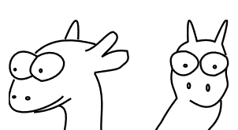
The ABA Dragon
Head* old_head = current_head.load();
Head* next_head = old_head->next;

Slide 57
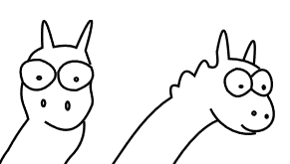
The ABA Dragon
Head* old_head = current_head.load();
Head* next_head = old_head->next;
Head* next_head = old_head->next;
if (current_head.CAS(old_head, next_head))
return old_head;

Slide 58
The ABA Dragon
Head* next_head = old_head->next;
if (current_head.CAS(old_head, next_head))
return old_head;
return nullptr;
Head* old_head = current_head.load();
Head* next_head = old_head->next;

Slide 59
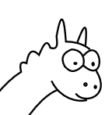
The ABA Dragon
Head* next_head = old_head->next;
if (current_head.CAS(old_head, next_head))
return old_head;

Slide 60
The ABA Dragon
Head* next_head = old_head->next;
if (current_head.CAS(old_head, next_head))
return old_head;
Convicted of UB

Slide 61
The ABA Dragon
Default choice should be mutex or proven concurrent container
For lock-free trail there is a bunch existing proven algorithm to explore
You may find your way by exploring those:
tagged/versioned heads
hazard pointers
epochs/RCU
CAS algorithms that treat the same value as unchanged
a stale CAS succeeds after a pointer leaves and returns
every atomic comparison is truthful
track identity and reclaim nodes safely or use a mutex

Slide 62
Zookeeper rule #5
The Dragon was only a glimpse beyond the marked paths.
Advanced concurrency has more traps than one talk can cage.
Prefer proven components over clever local inventions
Demand a measured reason for concurrency
If you cannot explain the guarantees, step back

Slide 63
What happened?
Wrong count shared read-modify-write
Crash a thread outlived what it touched
Silence waiting for the wrong event or circular locking
Slow but correct serialization or cache coherence ate the speedup
Déjà vu the same pointer value hid a changed generation
The code often looked reasonable.
The interleaving, lifetime, and hardware told the truth.

Slide 64
Before you spawn the thread
Once upon a time, a developer was about to spawn a thread.
This time, they stopped and asked who owned what.
What does this thread own?
What state is shared?
What protects the whole invariant?
What keeps every referenced object alive?
What guarantees progress and shutdown?
How will we prove the concurrency helped?

Slide 65
Thank you!
Jana Machutová

